Slide 1
Outline
Instruction Level Parallelism (ILP)
Dependencies and Hazards
Compiler Techniques to increase ILP
Dynamic Scheduling
Tomasulo’s Algorithm
Parallel Processing
Flynn’s Classification
Challenges in Parallel Processing
Shared Memory Architecture
Cache Coherence Problem
Conclusion

Slide 2
Instruction Level Parallelism (ILP)

Slide 3
What’s ILP
Architectural technique that allows the overlap of individual machine operations.
( add, mul, load, store …)
Multiple operations will execute in parallel. (simultaneously)
Goal: Speed Up the execution
Example:
load R1 ← R2 add R3 ← R3, “1”
add R3 ← R3, “1” add R4 ← R3, R2
add R4 ← R4, R2 store [R4] ← R0

Slide 4
Example: Sequential vs ILP
Sequential execution (Without ILP)
Add r1, r2 → r8 4 cycles
Add r3, r4 → r7 4 cycles 8 cycles
ILP execution (overlap execution)
Add r1, r2 → r8
Add r3, r4 → r7
Total of 5 cycles

Slide 5
ILP vs Parallel Processing
ILP
Overlap individual machine operations - Executes in parallel.
Transparent to the user
Goal: speed up execution
Parallel Processing
Separate processors getting separate chunks of the program.
Nontransparent to the user
Goal: speed up and quality up

Slide 6
ILP Challenges
1. H/W terminology Data Hazards ( RAW, WAR, WAW)
2. S/W terminology Data Dependencies

Slide 7
Data Dependence and Hazards
Instr_{J} is data dependent on Instr_{I:}
1. Instr_{J} reads operand written by Instr_{I}
I: add r1,r2,r3
J: sub r4,r1,r3
2. Instr_{J} is data dependent on Instr_{K} which is dependent on Instr_{I}
If two instructions are data dependent, they cannot execute simultaneously or be completely overlapped.
Data dependence in instruction sequence ⇒ data dependence in source code ⇒ effect of original data dependence must be preserved.
Hazard caused due to data dependence in pipeline is called as Read After Write (RAW) hazard

Slide 8
Types of Dependencies
Name dependencies
Output dependence
Anti-dependence
Data True dependence
Control Dependence

Slide 9
Name dependences
Output dependence
Instruction i and j writes the same register or memory location.
The ordering is preserved to leave the correct value in the register.
For Example: i: add r7,r4,r3
j: div r7,r2,r8
Anti-dependence
Instruction j writes a register or memory location that instruction i reads.
For Example : i : add r6,r5,r4
j: sub r5,r8,r11

Slide 10
Data Dependences
An instruction j is data dependent on instruction i if either of the following hold:
The result of Instruction I may be used by instruction j.
Instruction j is data dependent on instruction k, and instruction k is data dependent on instruction i.
LOOP LD F0, 0(R1) -> i
ADD F4, F0, F2 -> j
SD F4, 0(R1) -> k
SUB R1, R1, -8
BNE R1, R2, LOOP

Slide 11
Control Dependences
Every instruction is control dependent on some set of branches, and, in general, these control dependencies must be preserved to preserve program order.
if p1 {
S1;
};
if p2 {
S2;
}
S1 is control dependent on p1, and S2 is control dependent on p2 but not on p1.
Two constraints imposed by control dependences:
An instruction that is control dependent on a branch cannot be moved before the branch.
An instruction that is not control dependent on a branch cannot be moved after the branch.

Slide 12
Compiler techniques to increase ILP
Register Renaming
Pipeline Scheduling
Loop Unrolling

Slide 13
Register Renaming
Instructions involved in a name dependence can execute simultaneously if name used in instructions is changed so instructions do not conflict.
Register renaming resolves name dependence for registers either by compiler or by HW.
I: sub r1,r4,r3
J: add r1,r2,r3
K: mul r6,r1,r7
I: sub r1,r4,r3
J: add r8,r2,r3
K: mul r6,r8,r7

Slide 14
Pipeline Scheduling
Rearranging and modifying instruction to maximize instruction execution overlap.
Assume following latencies for all examples
Instruction Instruction Latency stalls between producing result using result in cycles
FP ALU op Another FP ALU op 4 3
FP ALU op Store double 3 2
Load double FP ALU op 1 1
Load double Store double 1 0
Integer op Integer op 1 0

Slide 15
Pipeline Scheduling - Example
This code, add a scalar to a vector:
for (i=1000; i>0; i=i–1)
x[i] = x[i] + s;
First translate into MIPS code:
Loop: L.D F0,0(R1) ;F0=vector element
ADD.D F4,F0,F2 ;add scalar from F2
S.D F4, 0(R1);store result
DADDUI R1,R1,#-8;decrement pointer 8B (DW)
BNEZ R1,Loop ;branch R1!=zero

Slide 16
Loop Execution without Scheduling
1 Loop: L.D F0,0(R1) ;F0=vector element
2 stall
3 ADD.D F4,F0,F2 ;add scalar in F2
4 stall
5 stall
6 S.D F4, 0(R1) ;store result
7 DADDUI R1,R1,-8 ;decrement pointer 8B (DW)
8 stall ;assumes can’t forward to branch
9 BNEZ R1,Loop ;branch R1!=zero
9 clock cycles are required to execute the complete instruction

Slide 17
Loop Execution with Scheduling
1 Loop: L.D F0, 0(R1)
2 DADDUI R1, R1, #-8
3 ADD.D F4, F0, F2
4 Stall
5 Stall
6 S.D F4, 0(R1)
7 BNEZ R1,Loop;branch1!=zero
7 clock cycles are required to execute the complete instruction.

Slide 18
Loop Unrolling
The loop body is replicated multiple times.
More instructions in one loop to perform more overlapping.
Replicate body
Remove loop overhead
Rename registers
Schedule

Slide 19
Loop Unrolling - Four Times (straightforward way)
1-cycle stall
1 Loop: L.D F0,0(R1)
3 ADD.D F4,F0,F2
6 S.D 0(R1),F4 ;drop DSUBUI & BNEZ
7 L.D F6,-8(R1)
9 ADD.D F8,F6,F2
12 S.D -8(R1),F8 ;drop DSUBUI & BNEZ
13 L.D F10,-16(R1)
15 ADD.D F12,F10,F2
18 S.D -16(R1),F12 ;drop DSUBUI & BNEZ
19 L.D F14,-24(R1)
21 ADD.D F16,F14,F2
24 S.D -24(R1),F16
25 DADDUI R1,R1,#-32 ;alter to 4*8
26 BNEZ R1,LOOP
27 NOP
27 clock cycles, or 6.75 per iteration
(Assumes R1 is multiple of 4)
2-cycle stall

Slide 20
Loop Unrolling – Minimized Stalls
1 Loop: L.D F0,0(R1)
2 L.D F6,-8(R1)
3 L.D F10,-16(R1)
4 L.D F14,-24(R1)
5 ADD.D F4,F0,F2
6 ADD.D F8,F6,F2
7 ADD.D F12,F10,F2
8 ADD.D F16,F14,F2
9 S.D F4,0(R1)
10 S.D F8,-8(R1)
11 S.D F12,-16(R1)
12 DSUBUI R1,R1,#32
13 S.D F16, 8(R1); 8-32 = -24
14 BNEZ R1,LOOP
14 clock cycles, or 3.5 per iteration

Slide 21
Parallel Processing
Parallel Processing is an efficient form of information processing which emphasizes the exploitation of concurrent events.
Concurrency implies parallelism, simultaneity and pipelining.
Multiple jobs or programs –multiprogramming
Time sharing
Multiprocessing

Slide 22
Parallel Processing – Contd..
Parallel Processing requires knowledge of:
Algorithms
Languages
Software
Hardware
Performance Evaluation
Computing Alternatives

Slide 23
Parallel Processing – Contd..
Parallel Processing in UniProcessor:
Multiple Functional Units
Pipelining, Parallel Adders, Carry Look Ahead Adders
Overlapped CPU and I/O operation
Use of Hierarchical Memory
Balancing Subsystem Bandwidth
Multiprogramming and Time Sharing

Slide 24
Parallel Processing - Examples
Embedded Systems
Scientific Applications

Slide 25
Flynn’s Classification of Computer Architectures (Derived from Michael Flynn, 1972)
Michael Flynn proposed a classification for computer architectures based on the number of instruction steams and data streams (Flynn’s Taxonomy).
Flynn uses the stream concept for describing a machine's structure
A stream simply means a sequence of items (data or instructions).
The classification of computer architectures based on the number of instruction steams and data streams (Flynn’s Taxonomy).
Flynn’s Taxonomy
SISD: Single instruction single data
– Classical von Neumann architecture
SIMD: Single instruction multiple data
MISD: Multiple instructions single data
– Non existent, just listed for completeness
MIMD: Multiple instructions multiple data
– Most common and general parallel machine

Slide 26
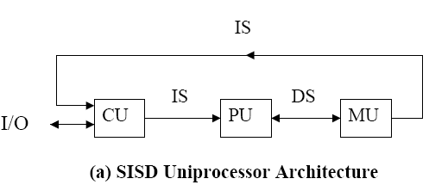
Flynn’s Classification of Computer Architectures (Derived from Michael Flynn, 1972)
SISD (Singe-Instruction stream, Singe-Data stream)
SISD corresponds to the traditional mono-processor ( von Neumann computer). A single data stream is being processed by one instruction stream OR
A single-processor computer (uni-processor) in which a single stream of instructions is generated from the program.
Captions:
CU -Control Unit; PU –Processing Unit
MU –Memory Unit; IS –Instruction Stream
DS –Date Stream

Slide 27
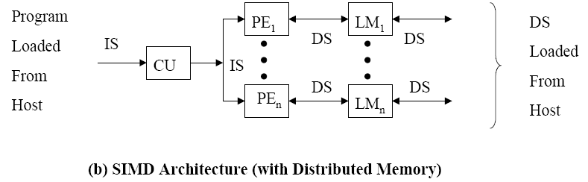
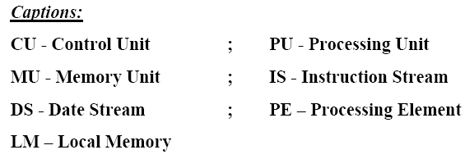
Flynn’s Classification of Computer Architectures (Derived from Michael Flynn, 1972) (contd…)
SIMD (Single-Instruction stream, Multiple-Data streams)
Each instruction is executed on a different set of data by different processors i.e multiple processing units of the same type process on multiple-data streams.
This group is dedicated to array processing machines.
Sometimes, vector processors can also be seen as a part of this group.

Slide 28
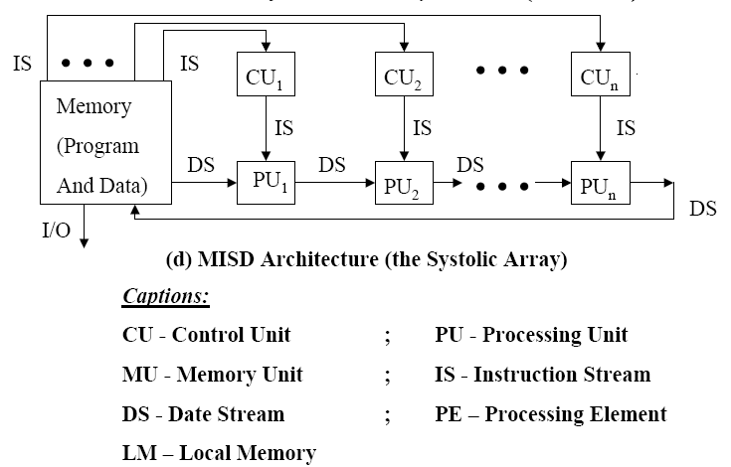
Flynn’s Classification of Computer Architectures (Derived from Michael Flynn, 1972) (contd…)
MISD (Multiple-Instruction streams, Singe-Data stream)
Each processor executes a different sequence of instructions.
In case of MISD computers, multiple processing units operate on one single-data stream .
In practice, this kind of organization has never been used

Slide 29
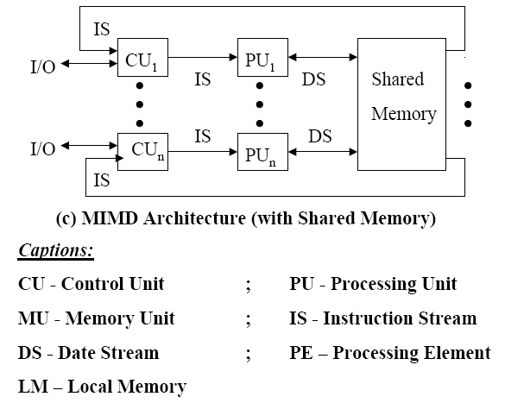
Flynn’s Classification of Computer Architectures (Derived from Michael Flynn, 1972) (contd…)
MIMD (Multiple-Instruction streams, Multiple-Data streams)
Each processor has a separate program.
An instruction stream is generated from each program.
Each instruction operates on different data.
This last machine type builds the group for the traditional multi-processors. Several processing units operate on multiple-data streams.

Slide 30
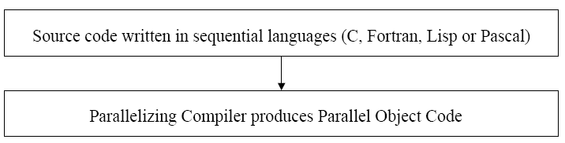
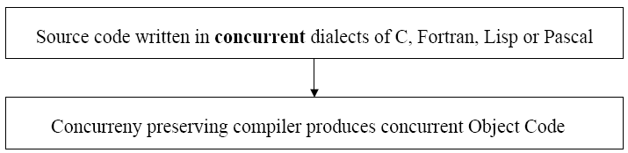
Two Approaches to Parallel Programming
Implicit Parallelism
Explicit Parallelism

Slide 31
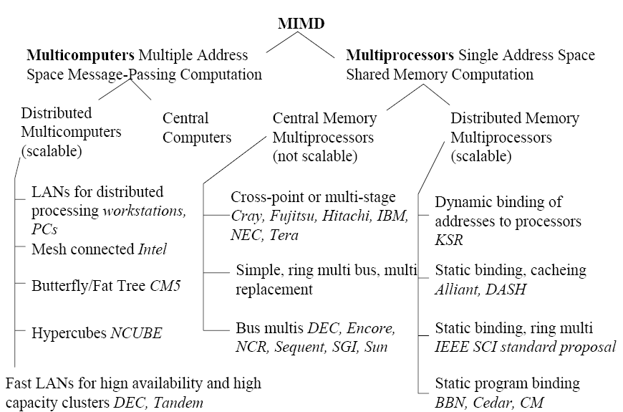
Bell’s Taxonomy of MIMD computers

Slide 32
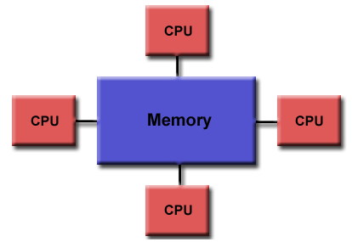
Challenges in Parallel Processing
Dealing with memory
Global Shared Memory
Distributed Shared Memory
Global shared memory with separate cache for processors
Potential Hazards:
Individual CPU caches or memories can become out of synch with each other. “Cache Coherence”
Solutions:
UMA/NUMA machines
Snoopy cache controllers
Write-through protocols

Slide 33
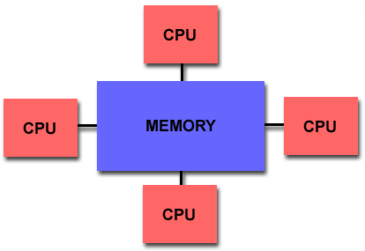
Shared memory architectures
Multiple CPU’s (or cores)
One memory with a global address space
May have many modules
All CPUs access all memory through the global address space
All CPUs can make changes to the shared memory
Changes made by one processor are visible to all other processors?
Data parallelism or function parallelism?

Slide 34
Shared memory architectures
How to connect CPUs and memory?

Slide 35
Shared memory architectures
One large memory
One the same side of the interconnect
Mostly Bus
Memory reference has the same latency
Uniform memory access (UMA)
Many small memories
Local and remote memory
Memory latency is different
Non-uniform memory access (NUMA)

Slide 36
Cache coherence problem
Due to the cache copies of the memory, different processors will see different values of the same memory location.
Processors see different values for u after event 3.
With write-back cache, memory stores the stale date.

Slide 37
Bus Snoopy Cache Coherence protocols
Memory: Centralized with uniform access time and bus interconnect.
Example: All Intel Multi Processor machines.
Notes:
37

Slide 38
Bus Snooping idea
All requests for data are sent to all processors (through the bus).
Processors snoop to see if they have a copy and respond accordingly.
Cache listens to both CPU and BUS.
The state of a cache line may change by (1) CPU memory operation, and (2) bus transaction (remote CPU’s memory operation).
Requires broadcast since caching information is at processors.
Bus is a natural broadcast medium.
Bus (centralized medium) also serializes requests.
Dominates small scale machines.

Slide 39
Types of snoopy bus protocols
Write invalidate protocols
Write to shared data: an invalidate is sent to the bus (all caches snoop and invalidate copies).
Write broadcast protocols (typically write through)
Write to shared data: broadcast on bus, processors snoop and update any copies.

Slide 40
Conclusion
What is ILP?
Dependencies
Dynamic Scheduling
Tomasulo’s Algorithm
What is Parallel Processing?
Flynn’s Classification
Challenges in Parallel Processing
Solutions
Share memory architectures
Cache coherence problem
Cache coherence protocols
Snoopy bus

